Slide 1



Housing Pricing Prediction
Machine Learning – EDA – Python – Data Science – Artificial intelligence
@SanDogra

Slide 2



Problem Statement
This goal of notebook is to be focused on solving the problem of predicting house prices for house buyers and house sellers.
@SanDogra

Slide 3

Introduction
A house value is simply more than location and square footage. Like the features that make up a person, an educated party would want to know all aspects that give a house its value.
Who are interested
Client House Buyer
Client House Seller
@SanDogra

Slide 4

Data Loading & Description
Some factors which I can think of that directly influence house prices are the following:
Area of House * How old is the house
Location of the house
Market Proximity
Transport
How many floors does the house have
What material is used in the construction
Water /Electricity availability
Play area / parks for kids (if any)
If terrace is available
If car parking is available
If security is available
The dataset comprises of 1460 observations of 81 columns. Below is a table showing names of all the columns and their description.
@SanDogra

Slide 5

Data Exploration
Data Exploration is the key to getting insights from data. Practitioners say a good data exploration strategy can solve even complicated problems in a few hours. A good data exploration strategy comprises the following:
Univariate Analysis - We will use it to visualize one variable in one plot. Examples: histogram, density plot, etc.
Bivariate Analysis - We will use it to visualize two variables (x and y axis) in one plot. Examples: bar chart, line chart, area chart, etc.
Multivariate Analysis - As the name suggests, it will be used to visualize more than two variables at once. Examples: stacked bar chart, dodged bar chart, etc.
Cross Tables -They are used to compare the behavior of two categorical variables (used in pivot tables as well).
@SanDogra

Slide 6

Data Analysis
@SanDogra

Slide 7
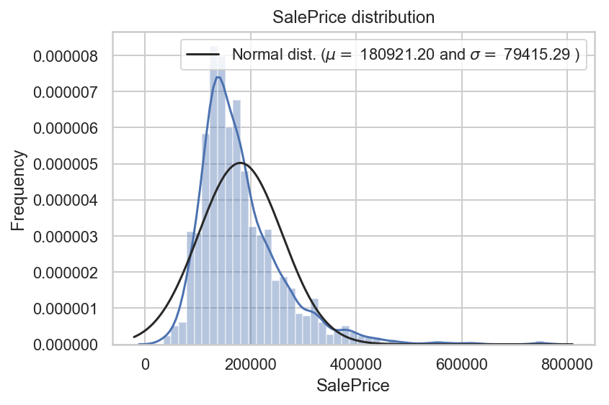
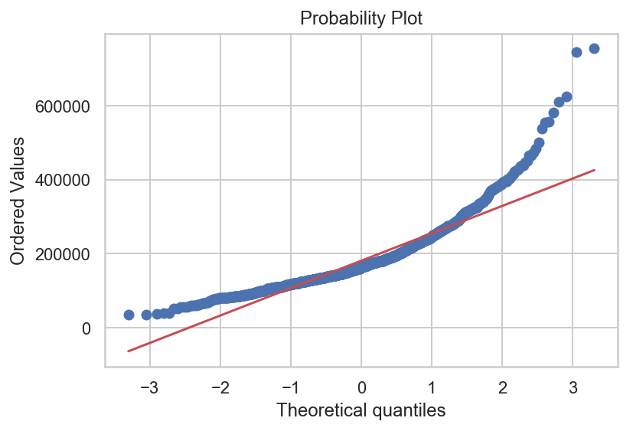
Analyzing the Test Variable - Target Analysis (Sale Price)
Current average price is at 180921. looking at krutosis is its not normal distribution
@SanDogra

Slide 8
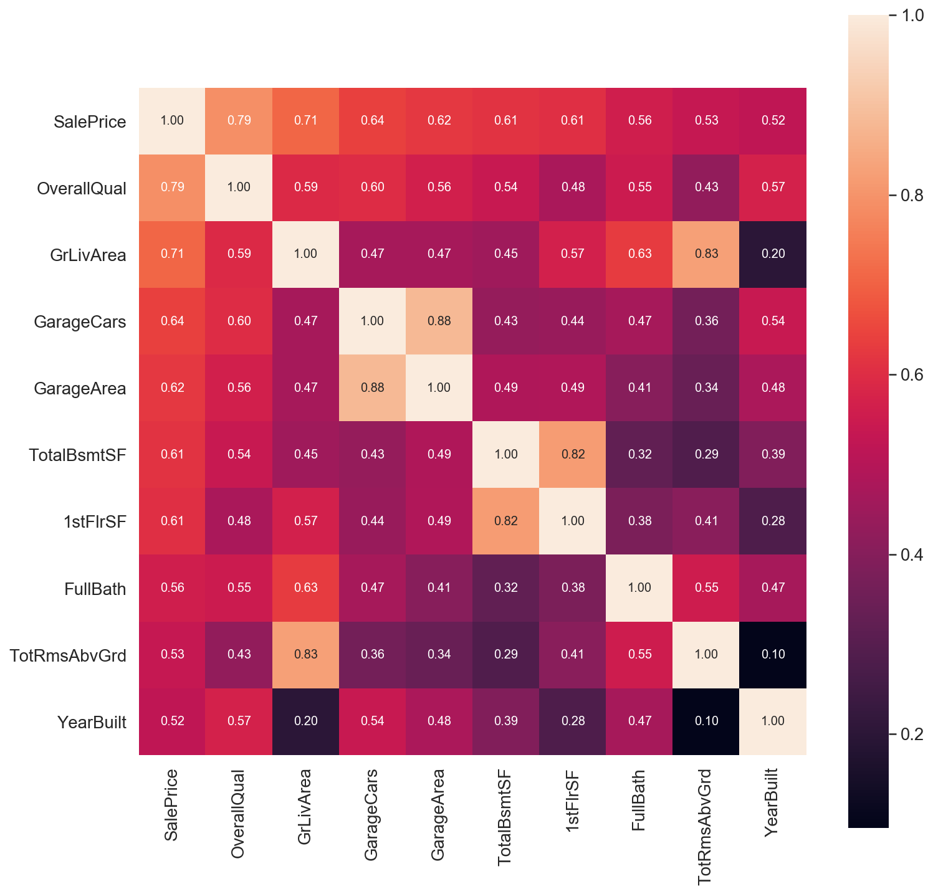
Multivariable Analysis
Top Correlated variable to Target are
OverallQual 0.790982
GrLivArea 0.708624
GarageCars 0.640409
GarageArea 0.623431
TotalBsmtSF 0.613581
1stFlrSF 0.605852

Slide 9
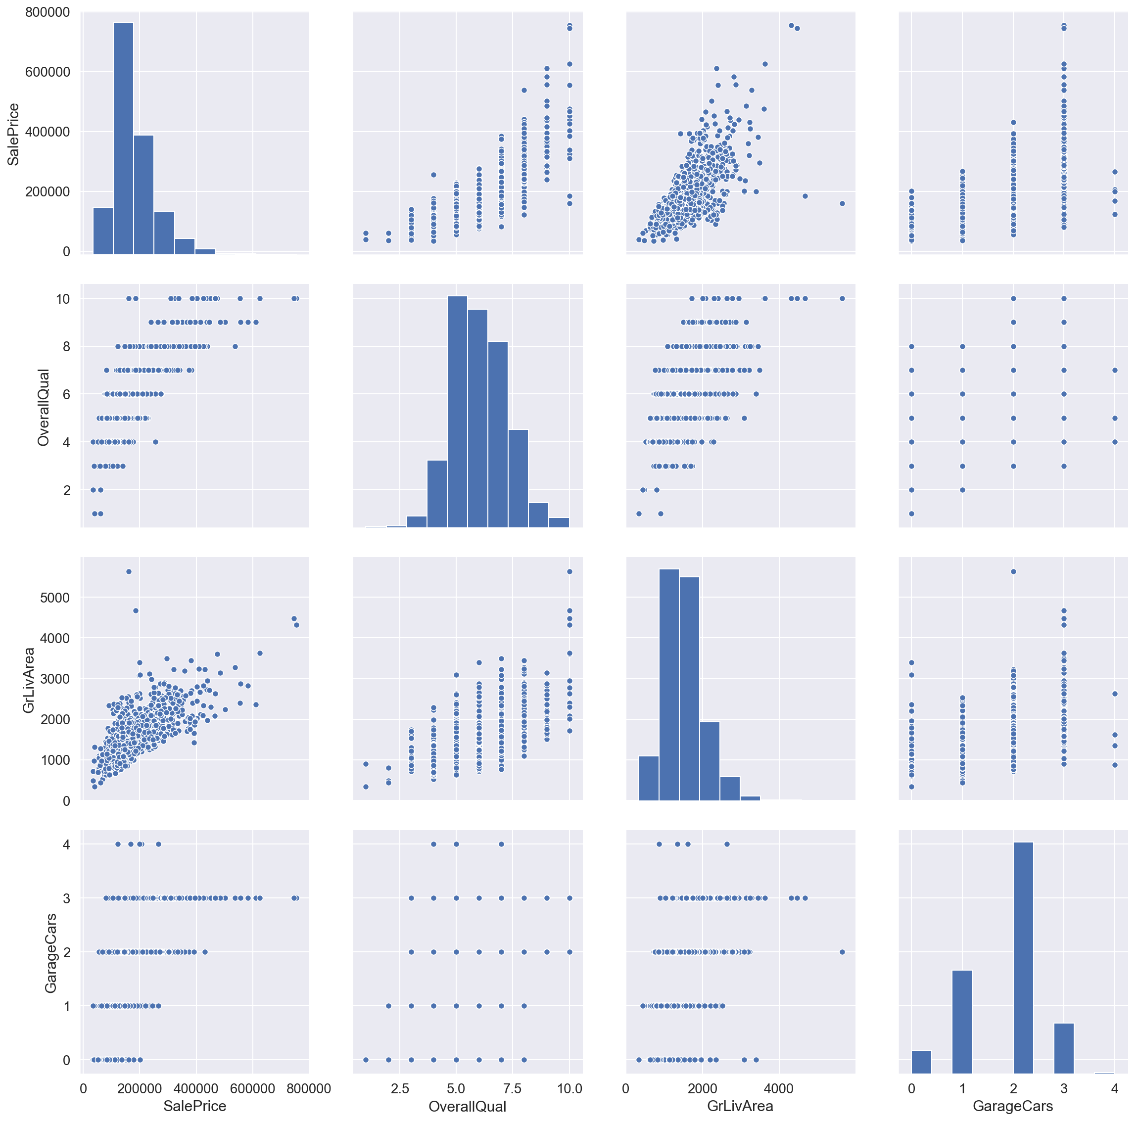
Multivariable Analysis
Pair Plotting of
SalePrice: The property Price
OverallQual: Rates the overall material and finish of the house (1 = Very Poor, 10 = Very Excellent)
GrLivArea: Above grade (ground) living area square feet
GarageCars: Size of garage in car capacity
@SanDogra

Slide 10
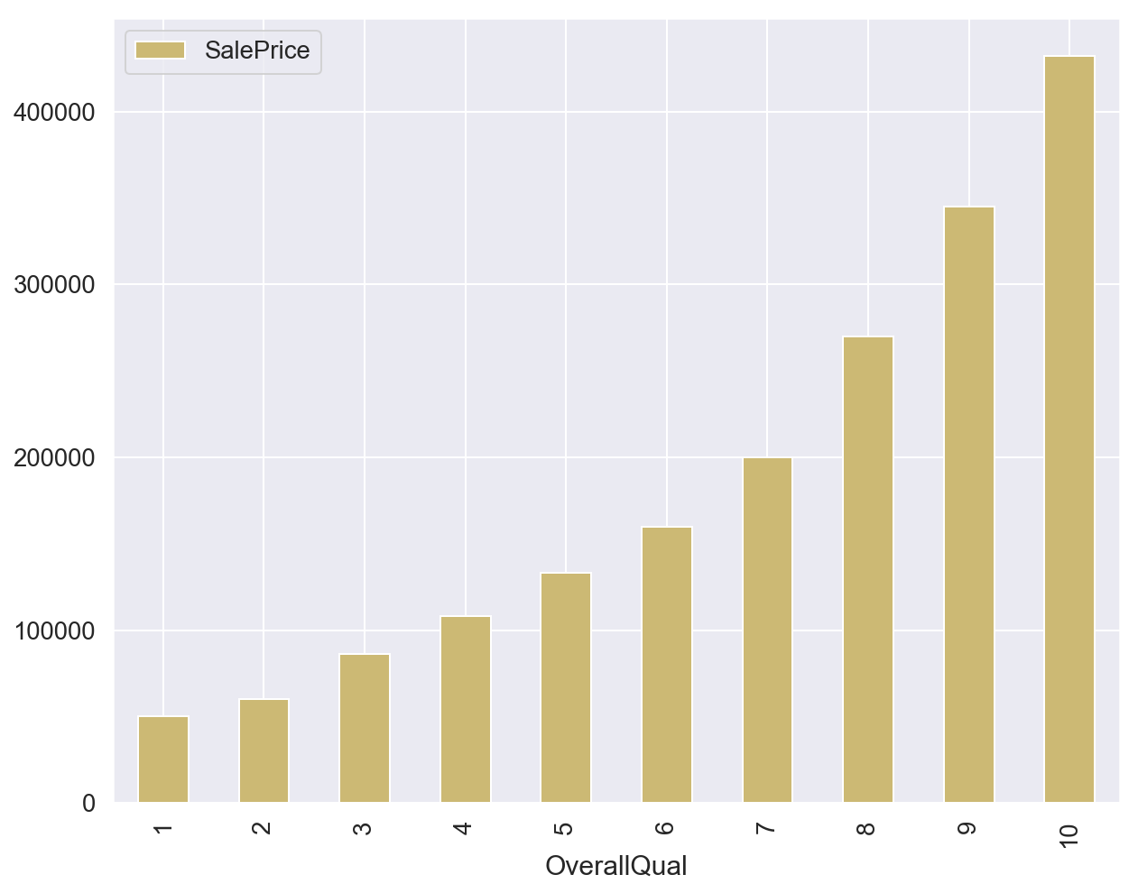
Bivariate Analysis - Sale Price & Overall Quality
Overall Quality of Property & Sale price has direct correlation
Higher the Quality Score, higher the price
@SanDogra

Slide 11
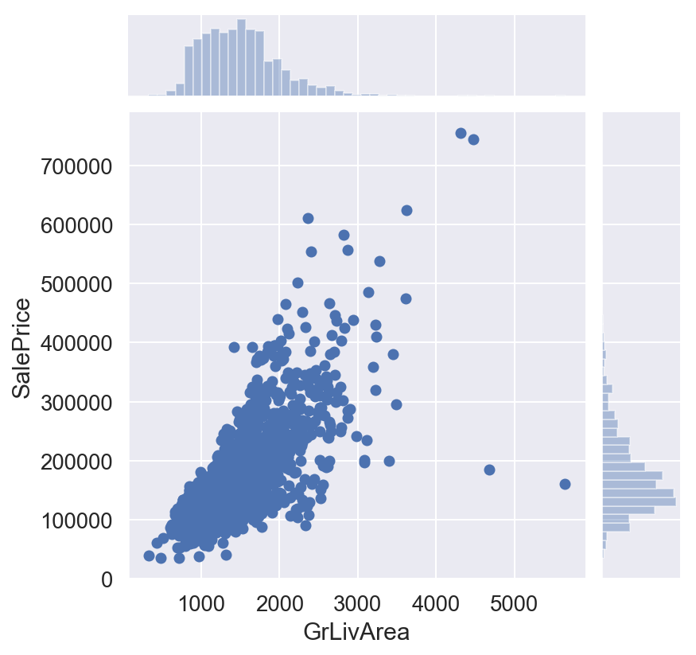
Bivariate Analysis - Sale Price & Living Area
Overall direct correlation
Concentrated at mid level
Outliers indicating some value deals and very high premium
@SanDogra

Slide 12
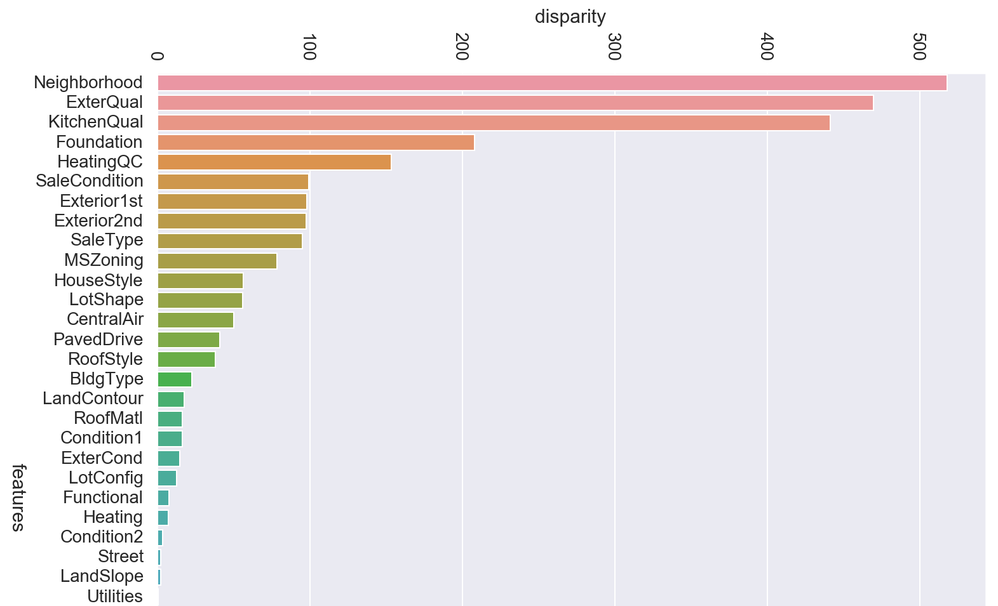
Categorical Feature Analysis
Following categorical features are given prime importance
Neighbourhood
Kitchen quality
Exterior wall Quality
@SanDogra

Slide 13
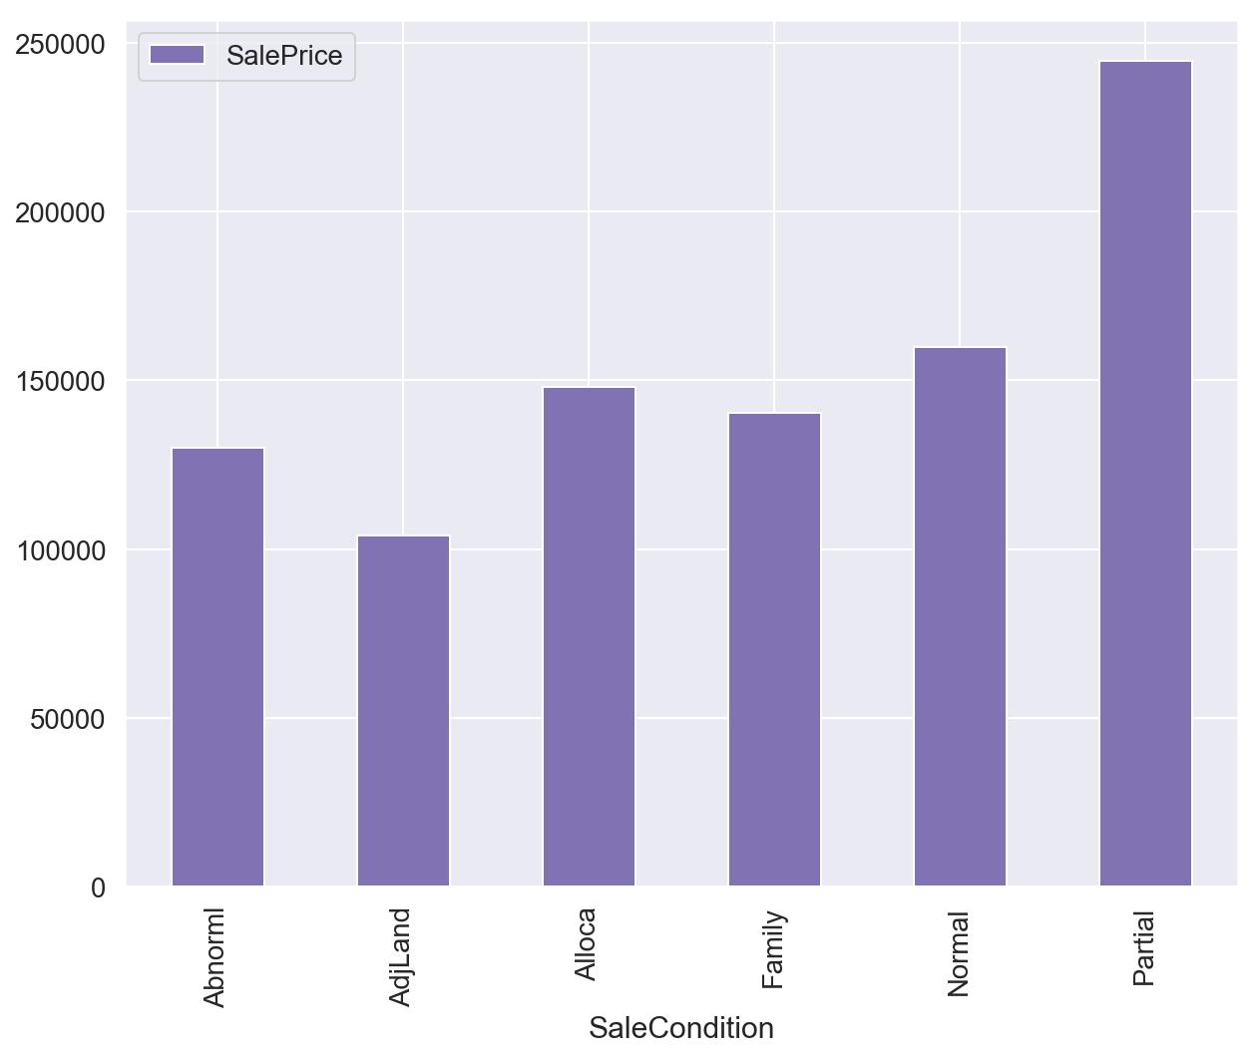
Categorical Feature Analysis
Sale Price has maximum correlation with Sales Condition partial
@SanDogra

Slide 14
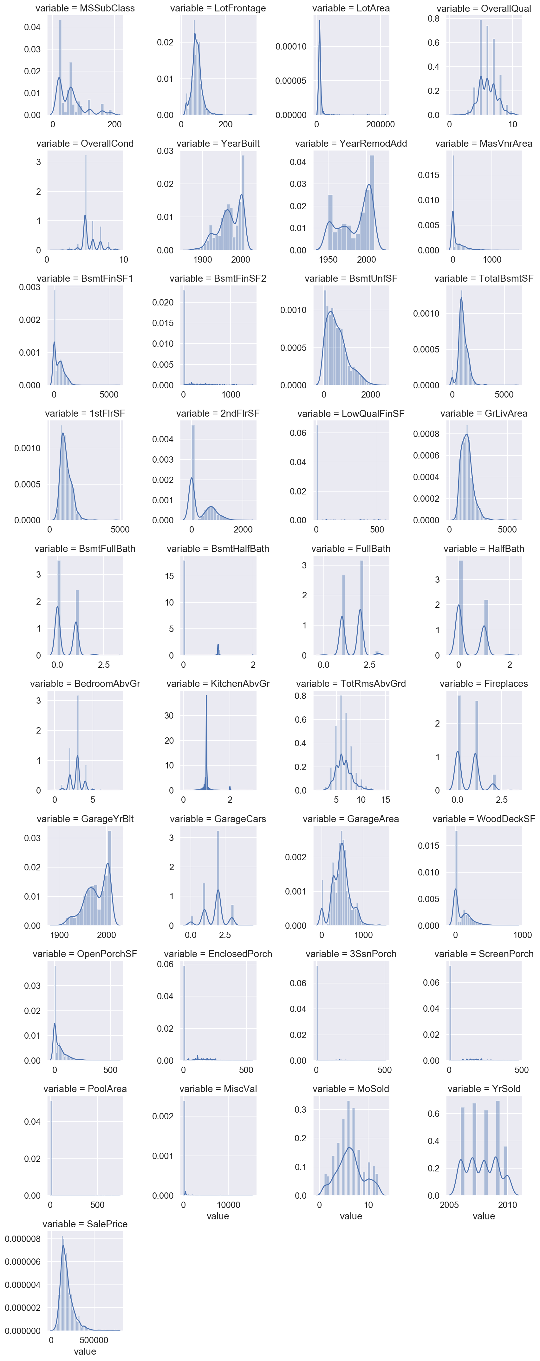
Numerical Variable Analysis
Histogram Analysis performed for numerical variables
Mostly are rightly skewed
@SanDogra

Slide 15
Categorical Variable Analysis
Box plot Analysis performed for categorical variables
Most of variables deal with outliers
Decision tree are best in dealing with it.
Contd…
@SanDogra

Slide 16
Categorical Variable Analysis
@SanDogra

Slide 17
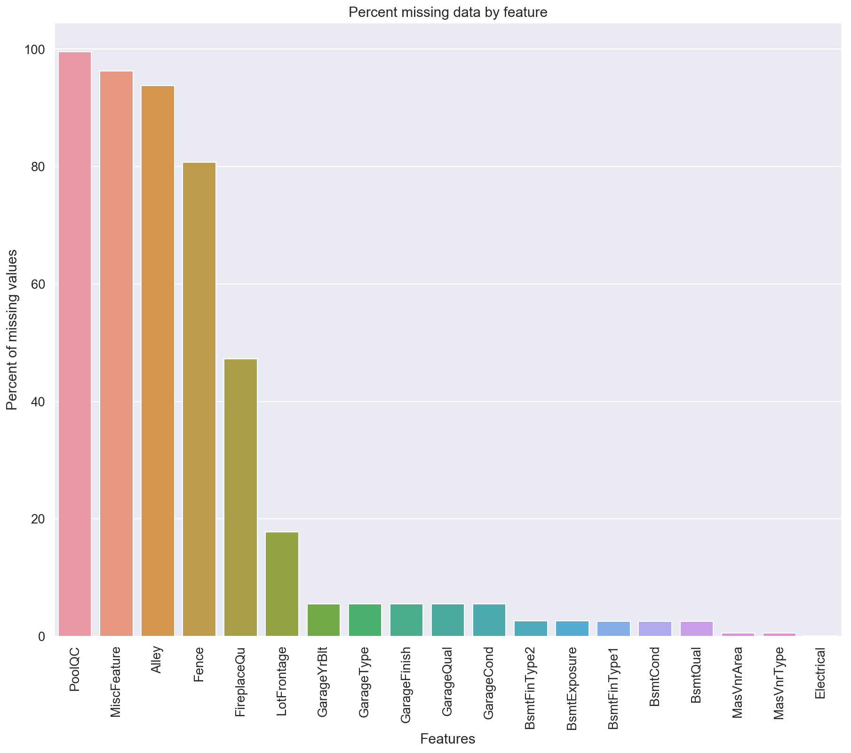
Data Pre-Processing
Features | Missing Ratio
PoolQC | 99.520548
MiscFeature | 96.301370
Alley | 93.767123
Fence | 80.753425
FireplaceQu | 47.260274
LotFrontage | 17.739726
GarageYrBlt | 5.547945
GarageType | 5.547945
GarageFinish | 5.547945
GarageQual | 5.547945
GarageCond | 5.547945
BsmtFinType2 | 2.602740
BsmtExposure | 2.602740
BsmtFinType1 | 2.534247
BsmtCond | 2.534247
BsmtQual | 2.534247
MasVnrArea | 0.547945
MasVnrType | 0.547945
Electrical | 0.068493
Missing Values identified, and fixed
@SanDogra

Slide 18
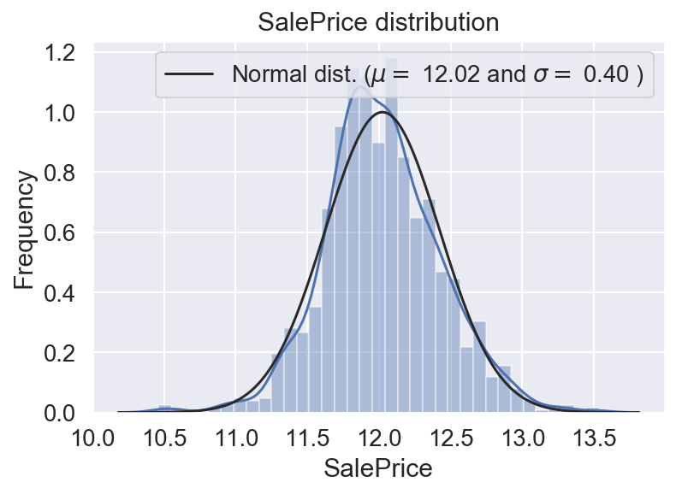
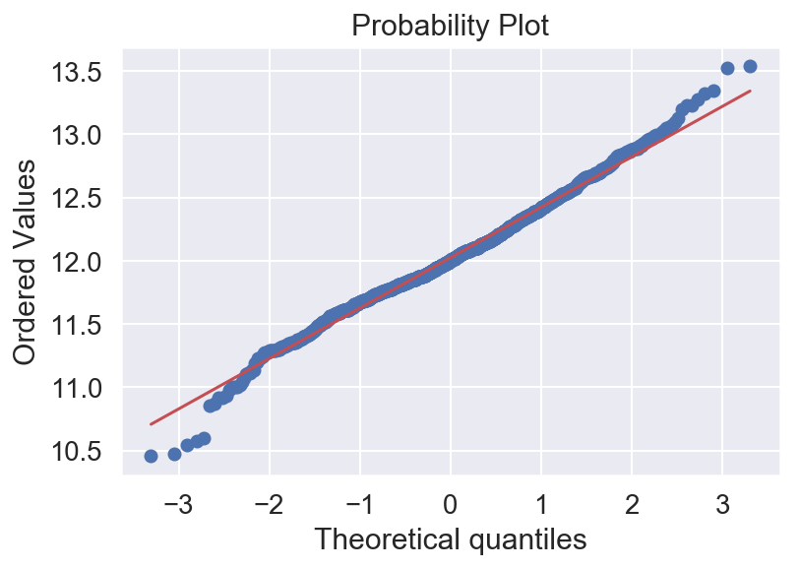
Feature Transformation or Feature Engineering
Skewness is brought under control
@SanDogra

Slide 19

Model Training, Evaluation and Predictions
@SanDogra

Slide 20
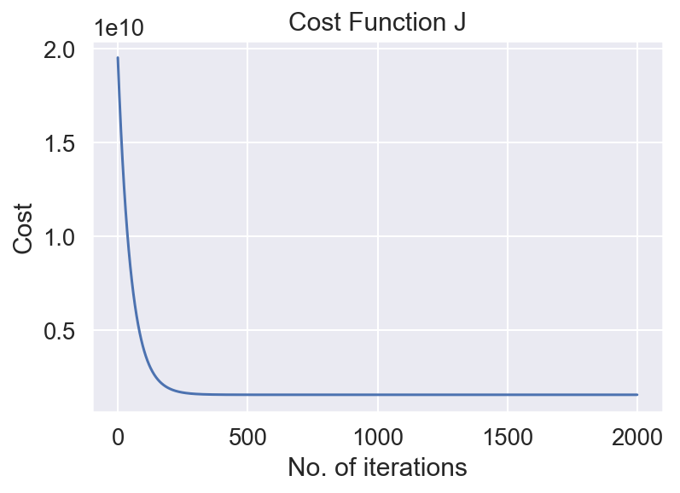
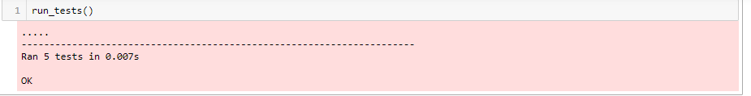
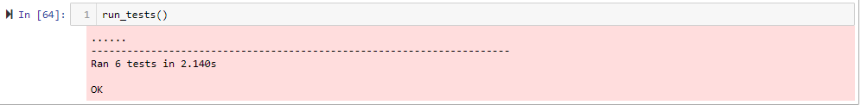
Linear Regression
Test conduced with Living area & Sale Price
@SanDogra

Slide 21
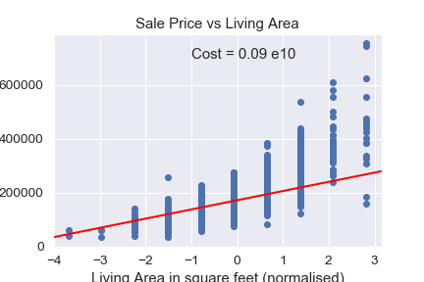
Linear Regression
Result plotted in animation
Check Jupiter Notebook
@SanDogra

Slide 22
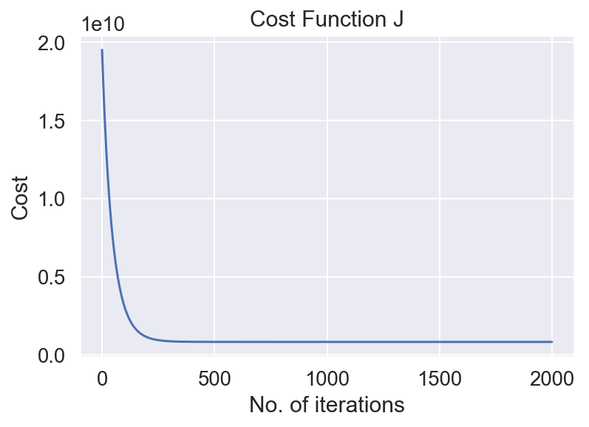
Multivariable Linear Regression
Test conduced with Overall Qual, Living area, GarageCars & Sale Price
@SanDogra

Slide 23
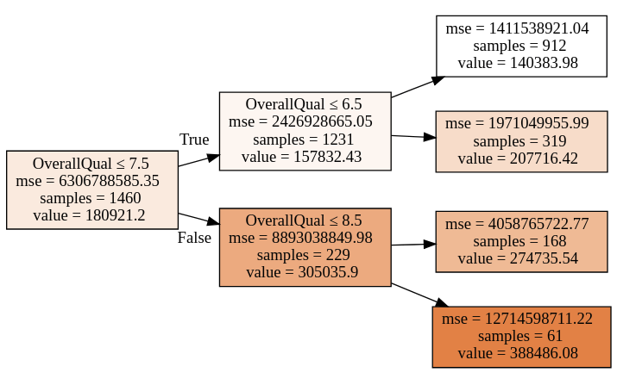
Decision Tree Regressor
Id | SalePrice
1 | 174600.000000
2 | 168900.000000
3 | 203980.000000
4 | 219288.888889
5 | 296236.000000
6 | 123700.000000
7 | 231000.000000
8 | 218785.714286
9 | 190083.333333
10 | 114080.000000
Test conducted on Train data & Test Data
R2 Score low
Result
@SanDogra

Slide 24
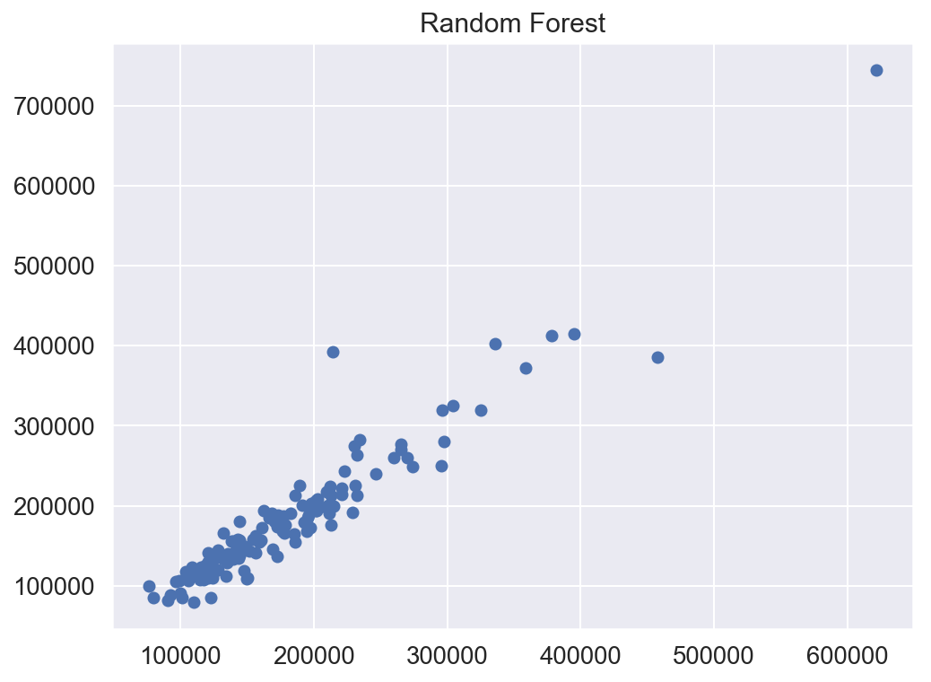
Random Forest Regressor
Test conducted on Train data & Test Data
High R2 Score (0.9769)
Result is plotted
@SanDogra

Slide 25
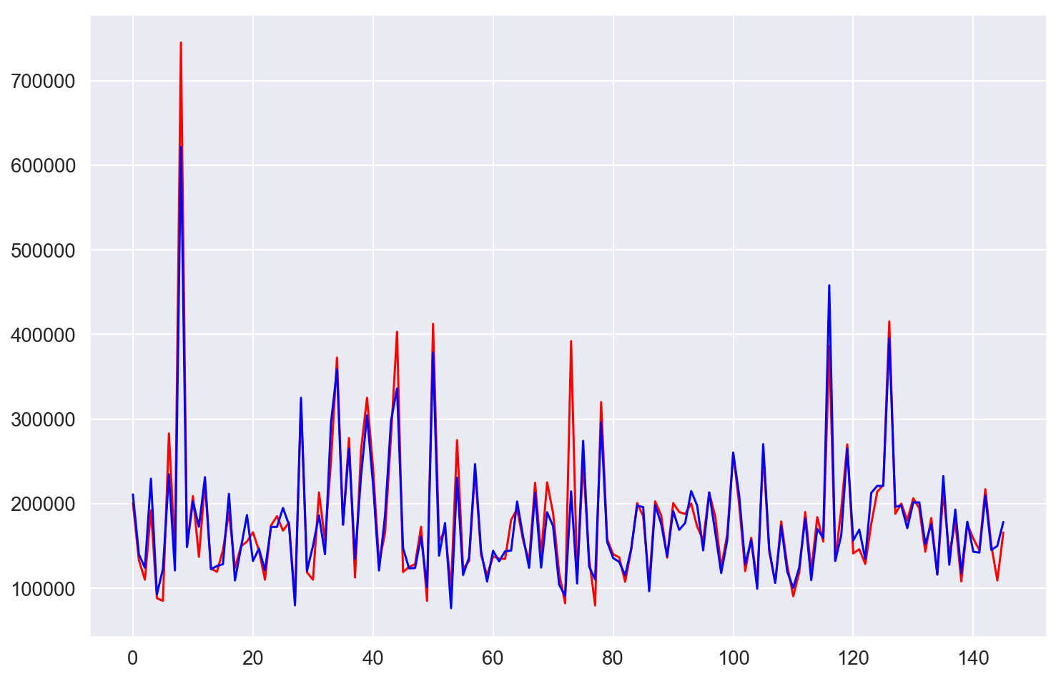
Random Forest Regressor
Result is perfect.
Blue line depicts perfect prediction
@SanDogra

Slide 26

Conclusion
@SanDogra

Slide 27



Data Science is about discovering hidden patterns (laws) in data. Observing data is as important as discovering patterns in our data. Without examining the data, our pattern detection will be imperfect and without pattern detection, we cannot draw any conclusions about analysed data. Therefore, both ideas are needed for drawing conclusions.
Study the variables.
What is the problem about? What are the target variables and what do the variables represent?
Variable analysis
We focused on the target variable and predicted variables and tried to clean up as many variables as possible
Machine Learning.
build and test our pattern detection algorithm
With the help of just a Random Forest Classifier (which is in fact Random Forest regression), it is possible to predict the house prices fairly good!
So, if you are about to buy a house, please contact me!
@SanDogra

Slide 28
Machine Learning_Housing Prices References
https://www.kaggle.com/erick5/predicting-house-prices-with-machine-learning
https://www.kaggle.com/dejavu23/house-prices-eda-to-ml-beginner
https://www.hackerearth.com/practice/machine-learning/machine-learning-projects/python-project/tutorial/
https://www.kaggle.com/thierryherrie/house-prices-random-forest
https://www.kaggle.com/rirodrig/house-prices-prediction-random-forest
https://www.data-blogger.com/2017/11/29/house-price-prediction-using-random-forest-classifier/
https://medium.com/@curiousily/predicting-house-prices-with-linear-regression-machine-learning-from-scratch-part-ii-47a0238aeac1
https://colab.research.google.com/drive/1DXkpo9PmH9_HiCSz9NQlZ9vGQtMIYqmF
linear regression
https://github.com/ShivaniMangal/House-Price-Prediction-EDA-and-ML-/blob/master/HOUSING%20PRICE%20PREDICTION.ipynb
https://towardsdatascience.com/machine-learning-project-predicting-boston-house-prices-with-regression-b4e47493633d
https://towardsdatascience.com/using-machine-learning-to-predict-home-prices-d5d534e42d38
https://nycdatascience.com/blog/student-works/housing-price-prediction-using-advanced-regression-analysis/
@SanDogra

Slide 29

Thank You
@SanDogra

Slide 30
Thank You
@SanDogra

